Slide 1
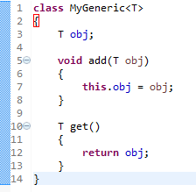
Generic class
A class that can refer to any type is known as generic class. Here, we are using T type parameter to create the generic class of specific type.
The T type indicates that it can refer to any type (like String, Integer, Employee etc.). The type you specify for the class, will be used to store and retrieve the data.

